Slide 1
Data Exploration and Analysis Project
By
Sravanthi Nallandula
21333747

Slide 2
Variables
My dataset is on Amazon top 50 Best-selling books.
In this dataset there are 7 variables in total:
Name
Author
User Rating
Reviews
Price
Year
Genre
I will be using the below 5 variables for my analysis.

Slide 3
Description of variables
Name: Name of the best-selling book with object datatype.
User Rating: Rating provided by the users, and this is of float datatype.
Reviews: Total number of reviews given by the users in integer format.
Price: Cost of the book in integer datatype.
Year: The year when the book is a best seller and will be in integer datatype.
Genre: Genre of the the book and it is of object datatype.

Slide 4
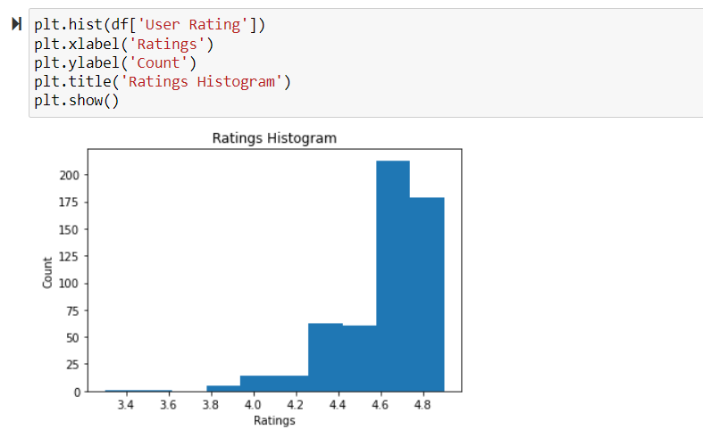
User Rating Histogram

Slide 5
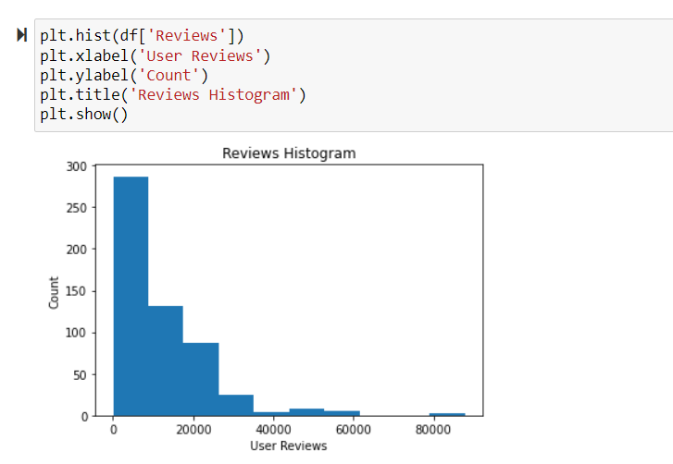
Reviews Histogram

Slide 6
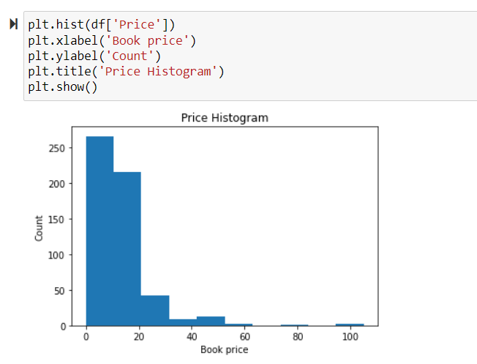
Price Histogram

Slide 7
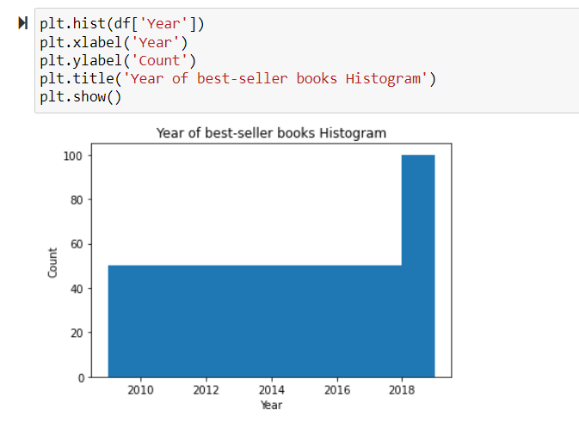
Year Histogram

Slide 8
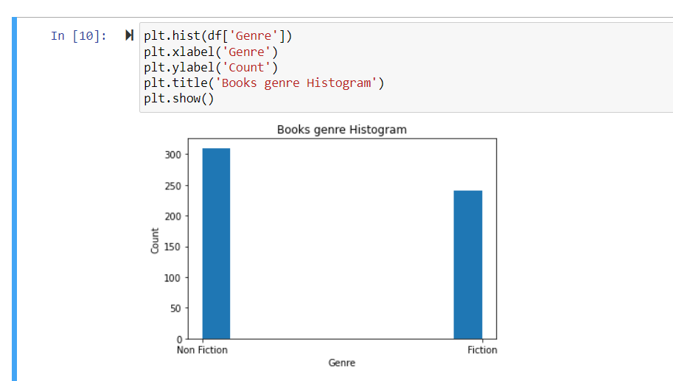
Genre Histogram

Slide 9
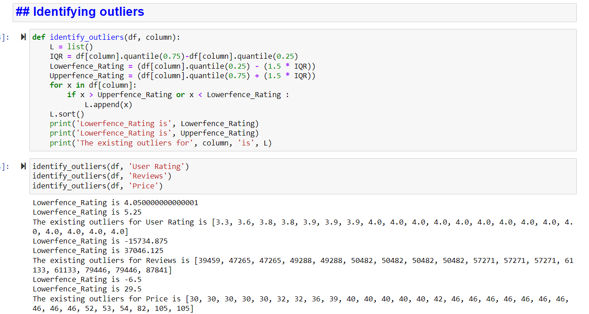
Identifying Outliers
Notes:
Outliers can be detected by finding out interquartile range. The values beyond the interquartile range are considered as outliers. There is no need to consider the values below lower fence 4.05 and above upper fence 5.25. If needed, we should remove the outliers depending on the purpose.

Slide 10
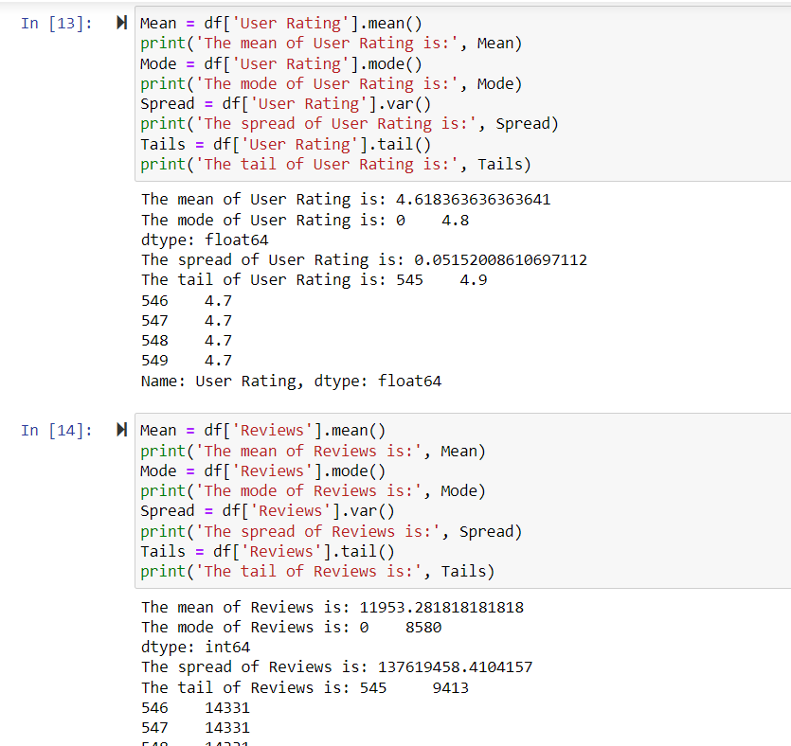
Descriptive characteristics

Slide 11
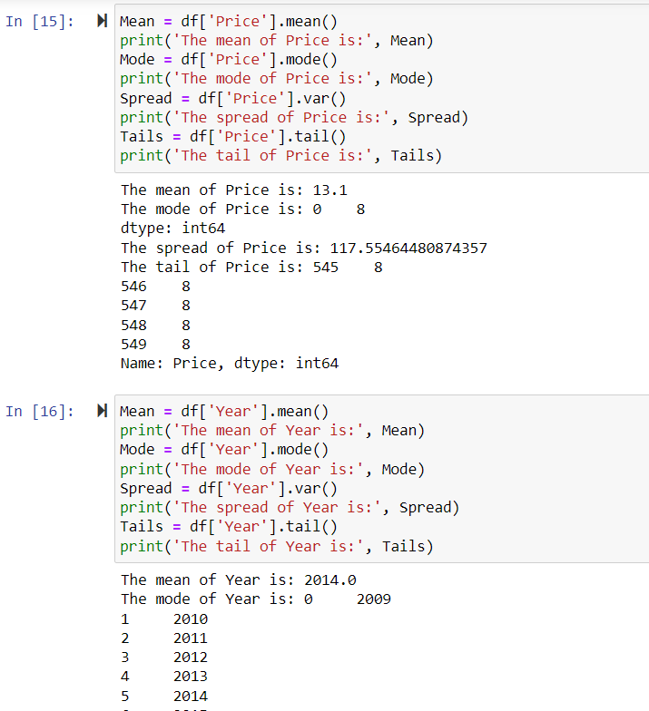

Slide 12
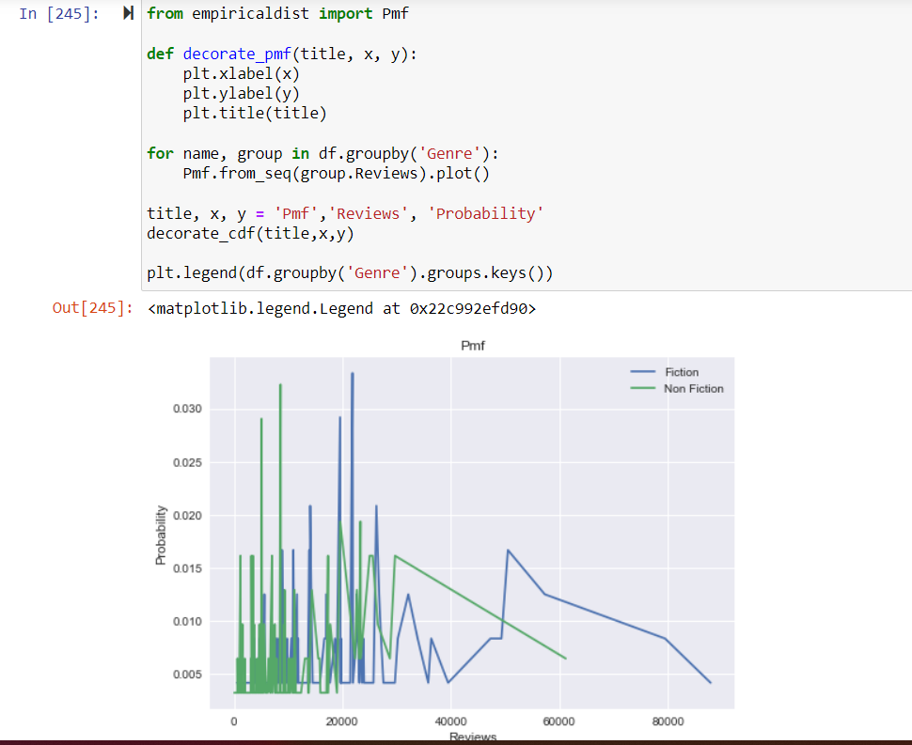
Probability Mass Function (PMF)
Notes:
There is no much difference in reviews between fiction and non-fiction books. The highest probability of reviews for fiction books are in between 20000 and 30000, approximately 25000 reviews. The highest probability of reviews for non fiction books is approximately 10000 reviews. In the slightest diffierence, fiction books reviews have more probability.

Slide 13
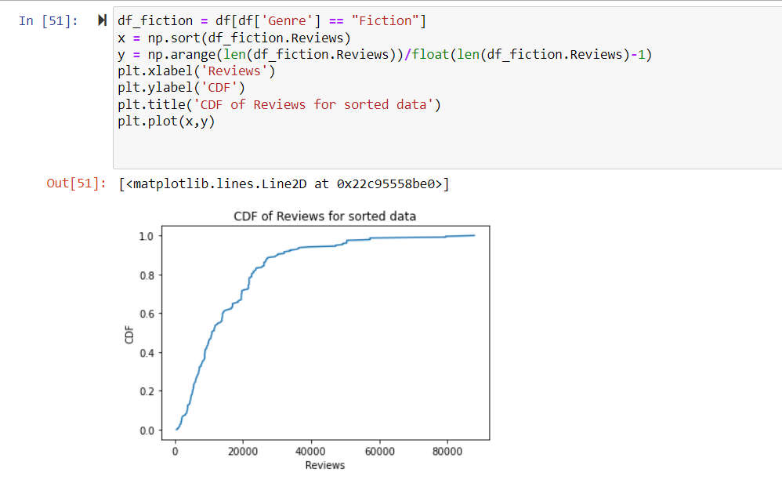
Cumulative Distribution Function (CDF)
Notes:
What is the probability of user reviews for all the books? Yes, it answers my question. The maximum reviews of all the books is approximately 60000 and the probability is 0.9

Slide 14
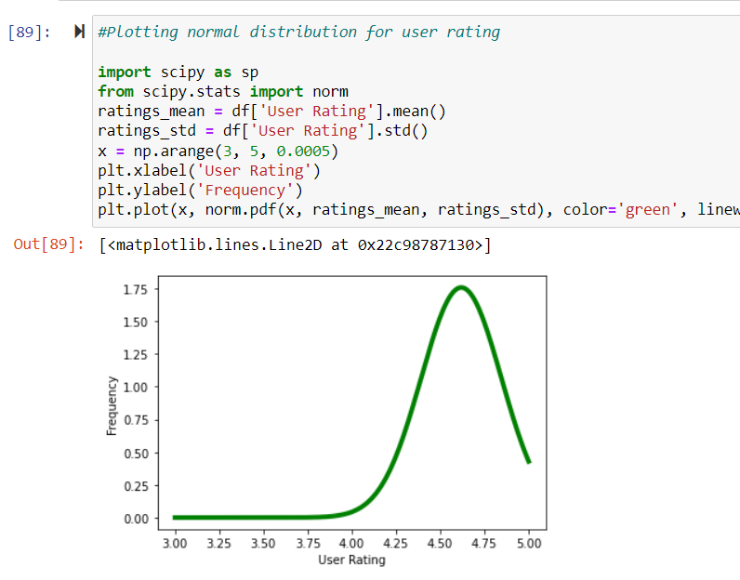
Normal Distribution
Notes:
The distribution of user rating is almost a bell-shaped curve, so this follows gaussian distribution.

Slide 15
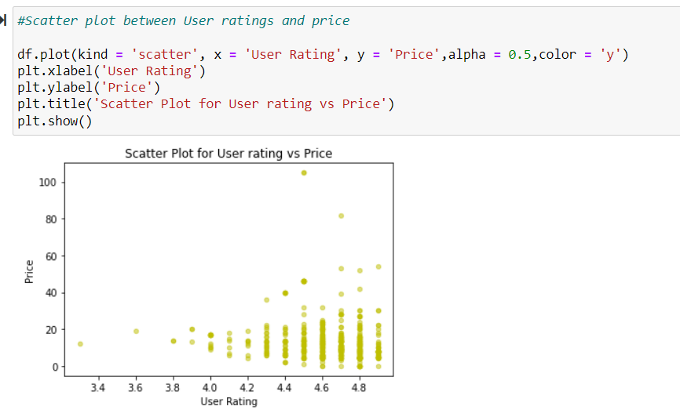
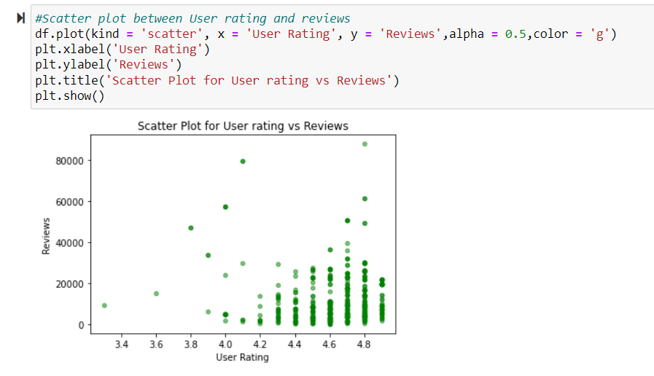
Scatter plots
Notes:
By looking at the scatter plots, we can identify the relation between variables. Most of the reviews are given to the books which are of lesser price and all are falling as a group under price of 40.
For user rating and reviews also, most of the reviews are given for the books having highest rating. By the graphs, we can say there is no strong relationship between User rating and price as well as user rating and reviews.

Slide 16
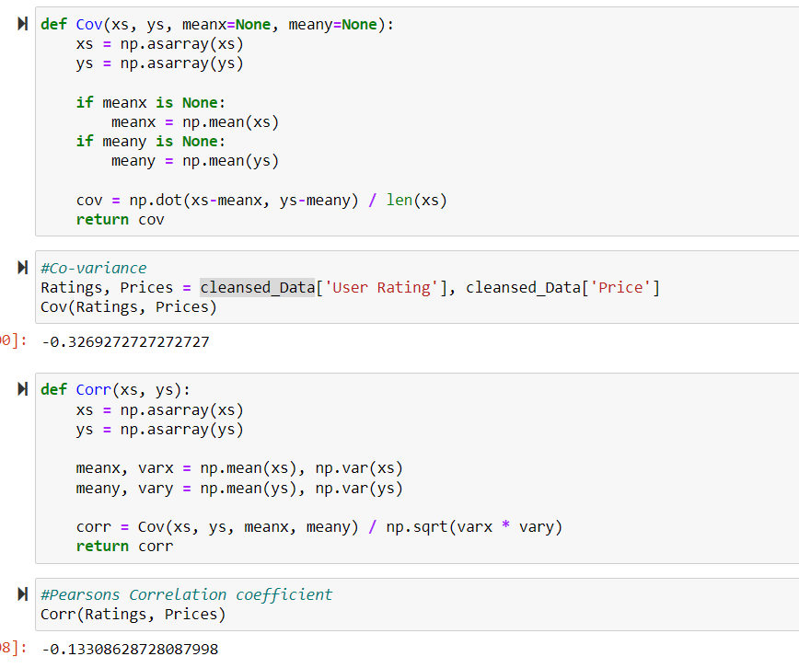
Covariance & Correlation
Notes:
Pearson's correlation is always in the range of -1 to 1. (including both). We say the correlation is positive if mean is positive, which suggests that when one variable is high, the other tends to be high as well. If mean is negative, the correlation is negative, so if one variable is high, the other is also high, the other is a low level.The correlation value is negative. By this we can say there is no strong relationship between rating and price. There is no perfect correlation in this case.

Slide 17
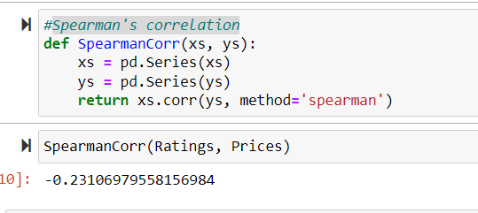
Spearman's correlation
Notes:
Spearman's correlation is a little low compared to pearson's correlation. If one of the distributions is skewed or contains outliers, Pearson's correlation can be altered (in either way). The rank correlation of Spearman is more reliable.

Slide 18
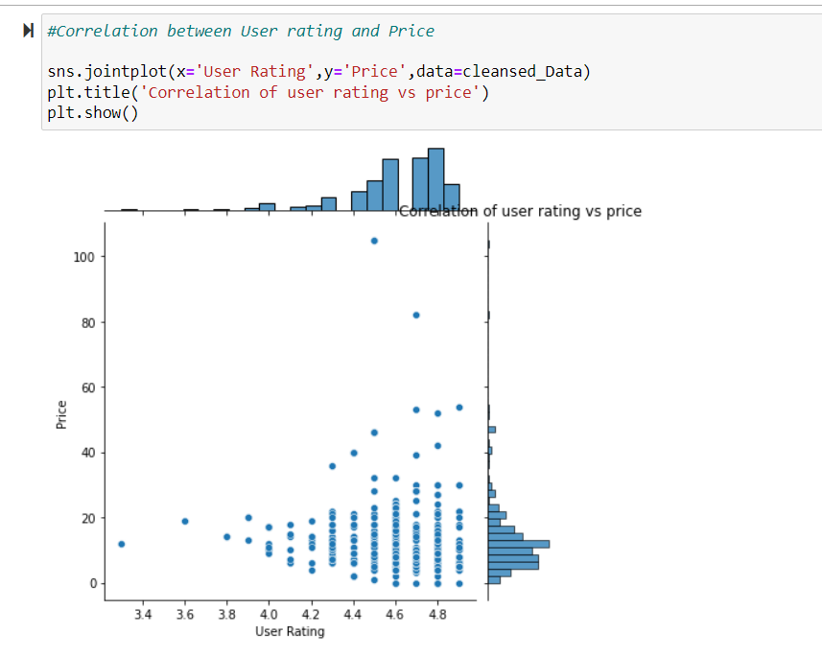
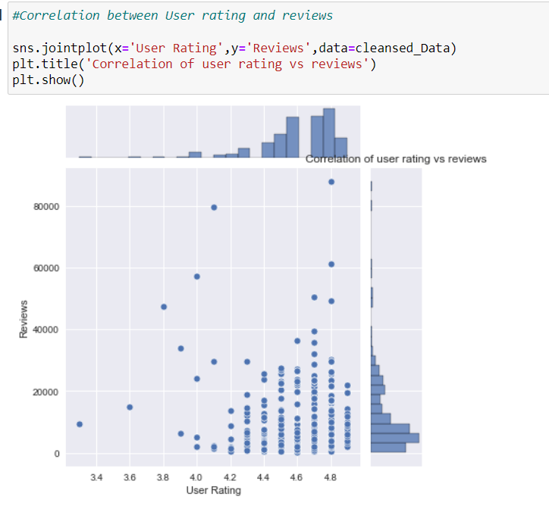
Plotting correlation
Notes:
By looking at the plot the relation in both the cases is very weak.

Slide 19
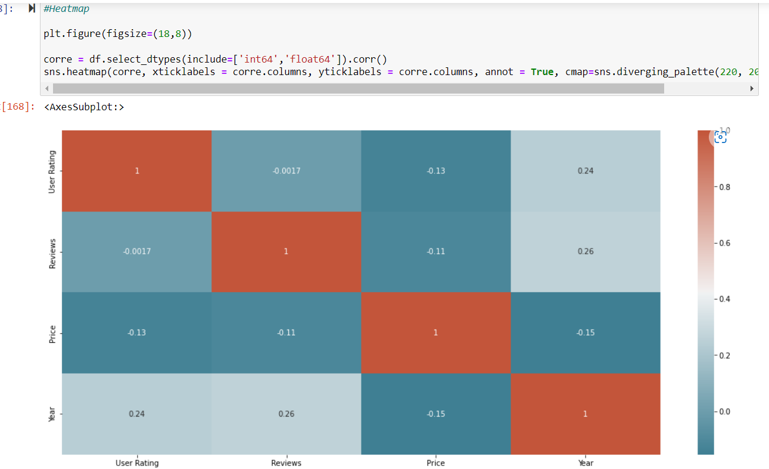
Heatmap

Slide 20
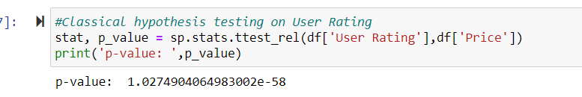
Hypothesis Testing
The impact is unlikely to be due to chance if the p-value is less than 1%; if it is larger than 10%, the effect can plausibly be explained by chance.
P-values in the range of 1% to 10% should be regarded borderline.
The value is less than zero, so there is no need to consider null hypothesis.

Slide 21
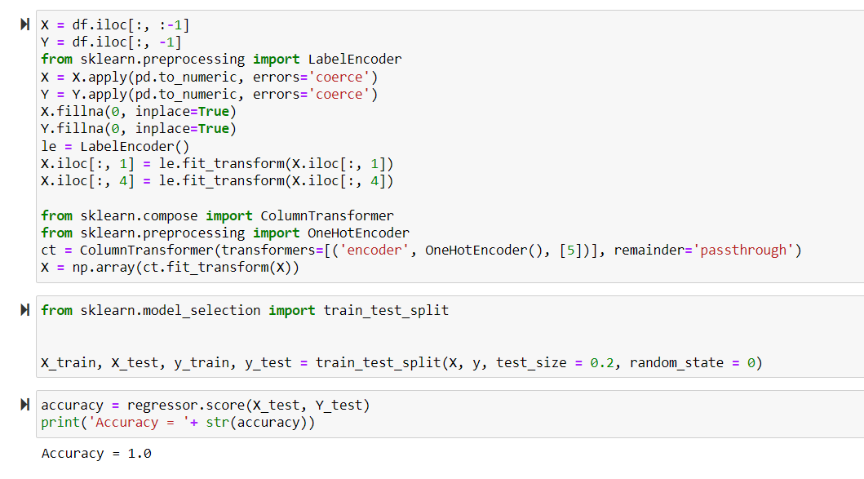
Regression Analysis
Notes:
Using multiple regression, relationships can be explored more systematically. The accuracy should range from 0 to 1. For accuracy 1.0, it is a perfect relationship.

